Slide 1

BAN240 – Business Analytics Consulting Capstone Project
Group 4 Members
Mohammed Mukshid Abdul Cader
Lesly Pearl Cortez
Tareq Haboukh
Amanpreet Kaur
April Tolosa
Fides Audrielle Urgel
Professor Stephen Perelgut
Date April 7, 2022
Notes:
YouTube Link: https://www.youtube.com/watch?v=yrUf3lOrEHI

Slide 2

Industry: Telecommunications
Topic: Comparison of the basic plan offers of the top cell phone plan providers in Canada and the US
Questions:
What are the top Telcom companies in Canada and the US?
What are mobile plans being offered by these Telcom companies?
Identify the key features such as price point, speed, data, etc.
What is the difference between Canada and the US mobile plans?
Who’s providing the best plan?
What can we recommend to Telecom companies to improve their mobile plans?

Slide 3

Background
Canada’s cell phone plans is the most expensive in the world.
By how much?
25% more compared to other countries
between 15%-40% more compared to the US.
The Big 3 Canadian telecom companies (Bell, Rogers and Telus) own 90% of the market and charge higher prices due to a lack of competition.
Why:
Expensive to start & operate
very restrictive licensing policies
Notes:
Thank you Lesly.
For our background...
Canada’s cell phone plans remain to be the most expensive in the world.
Canadians spend between 15%-40% more on their plans compared to Americans ,and 25% more compared to other countries.
Now it is Bell, Rogers and Telus who own 90% of the telco market here in Canada. They charge higher prices due to a lack of competition.
Why is there a lack of competion?
First, it very costly to start and operate this kind of business;
and secondly, there are some very restrictive licensing policies that discourages new competitors from entering the market.

Slide 4

Background
Recognizing this issue, in 2019, the Government of Canada released a policy to drive down the prices.
By January 2022, they successfully reduced mid-range wireless plans by 25% over two years.
They will still continue to rigorously push the reduction of prices of telecom services.
Notes:
Recognizing this issue, the Government of Canada released a policy to drive down the prices.
By January 2022, the Government successfully reduced the prices for mid-range wireless plans by 25%;
However, they will still continue to push the reduction of telcom service prices.

Slide 5

Background
WHAT: This study will compare the cell phone plan offers of the top plan providers in Canada and the US.
HOW: By looking into details using a standard criterion to determine which plan offers the best value for money.
By drilling down what features to utilize, the impediments of the review, what to focus on, and other significant elements.
WHY: To determine which plan offers the best value for money.
To show which aspects the business can focus on to be more competitive.
To give suggestions on how the government and the business can lower their prices.
Notes:
So what do we want to do?
This study will compare the cell phone plan offers of the top plan providers in Canada and the US.
To build a comparative view between Canada and American phone plans, it is worth looking into details using a standard criterion.
In doing so, this study can help drill down what features to utilize, the impediments of the review, what to focus on, and other significant elements.
Why are we doing this, what is our goal:
It is First, to determine which plan offers the best value for money.
Second, to show which aspects the business can focus on to be more competitive.
And finally, to give suggestions on how the government and the business can lower their prices.
To talk more about the Data, here is Fides.

Slide 6


Data Collection and Description
Semi-structured dataset
Self-describing – carries info about what its schema
Loosely-coupled data
Flexibility in adding new attributes and relationship
Citation: Wilkerson, Margaret. “Semistructured-Data model”. https://slideplayer.com/slide/13318356/
Common source: Whistle-out - most recent available plans offered to consumers. Foundation for analysis of performances of network service providers across the United States and Canada.
Existing and open to public information hence it is easily accessible, and the accuracy is very high.
Notes:
Thanks April. For the data collection procedure, the group decided on gathering a semi-structured as this is self-describing and loosely coupled that doesn’t follow a structured dataset. Although it isn't totally raw or unstructured, it contains a few primary features for simpler examination but with flexibility in adding new attributes and relationships which will be shown during the discussion of methodology.
The common source used for data gathering was WhistleOut – an examination site that helps in looking for cellphone plans offered to the consumers. The group considered this source as this existing and open to public that can be easily access with high accuracy.

Slide 7


Data Collection and Description
Identified key features included in a plan
Filtered numerous phone plans offered by the identified US & Canadian wireless telecommunication companies
Selected companies
US – Verizon, USCellular, T-Mobile, Sprint, AT&T
CA – Bell, Rogers, Telus, Freedom, Virgin Plus, Fido
Features | Description
Company | Selected Canada and US telecom provider
Plan | Description of mobile data plan offering
Price | Mobile data plans monthly fee in USD and CAD
Promotion | Promotion that can be avail during mobile data plan activation or sign-up
Fees | Activation fee or Sign-up fee
Local Minutes | Nationwide call duration inclusive in mobile data plan
International Minutes | International call duration inclusive in mobile data plan
Messages Type | Type of text plan included in the mobile data plan
Messages | Number of outgoing messages in the included text plan
Data | How much mobile data the user can access, usually per month, for a specific fee.
Speed/bandwidth | Maximum amount of data transmitted over an internet connection in a given amount of time
Contract | Stated duration or service term of mobile data plan
Availability | Location to where the mobile data plan can be purchased
Coverage | Stated locations of mobile carrier's network coverage
Notes:
To find the best mobile data plan, the group identified the key features included in a plan then filtered numerous phone plans offered by the selected US & Canadian telecom companies such as Verizon, USCellular, T-Mobile, Sprint, AT&T, Bell, Rogers, Telus, Freedom, Virgin Plus and Fido.
To be able to obtain insights, features collected and with brief description are listed in this table.
Now, for the Data Methodology and Analysis I will hand this over to Tareq.

Slide 8
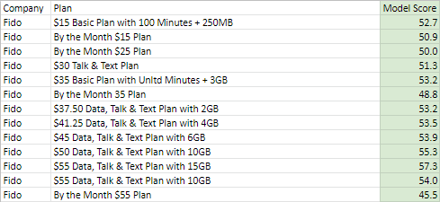

The Model
Methodology
Each plan then is evaluated and given a score by multiplying each normalized factor with how important it is to the Canadian consumer.
The Model score is between 0 and 100, the higher the better.
$$\text{Plan} \text{Score}\text{ = }\sum{{Normalized Factor}_{i} ×{Factor Importance}_{i}}$$
Notes:
Thank you, Fides, I would like to talk about the methodology behind our analysis and how we were able to compare and evaluate the performance of each cell phone service plan. to do so, we needed to create a model that is biased toward the needs of the Canadian consumer.
The model then calculates a score by the summation of Normalized Factors multiplied by the factor importance. This gives us a score from zero to one hundred. The higher the score the better the performance of the plan.

Slide 9

Most Influential Factors
Plan Price
Data Allowance
Speed/Bandwidth
Coverage
Talk & Text
Notes:
By looking at the data we gathered, we were able to identify the most influential factors in our analysis and they are Price, Data, Data Speed, Network Coverage, and finally text & talk.

Slide 10


Normalizing Factors
Factors are normalized to a scale from 0 to 1 using the formula:
$$\frac{Factor −Mean(Factor)}{Max\left(Factor\right)−Min(Factor)}$$
Notes:
In order to normalize each factor to a scale from zero to one, we used the following formula, the Factor minus the mean of factors over the maximum value minus the minimum value.

Slide 11

Factor Importance
Based on the CRTC report the following importance points were given to each Factor
Plan Price 40
Data Allowance 32.5
Speed/Bandwidth 10
Coverage 10
Talk & Text 5
Notes:
And then, based on the CRTC Mobile Services report we assigned different “Importance” points for each factor to influence the needs of the Canadian consumer in the model calculations.
This means that the model will favor plans with lower-Price and higher data allowance over other factors, by 40 and 32.5 points respectively. in contrast, most plans included text & talk which made them less important.
This is basically how our model works to calculate the score of a cell phone plan.
Amanpreet will talk about our findings next.

Slide 12

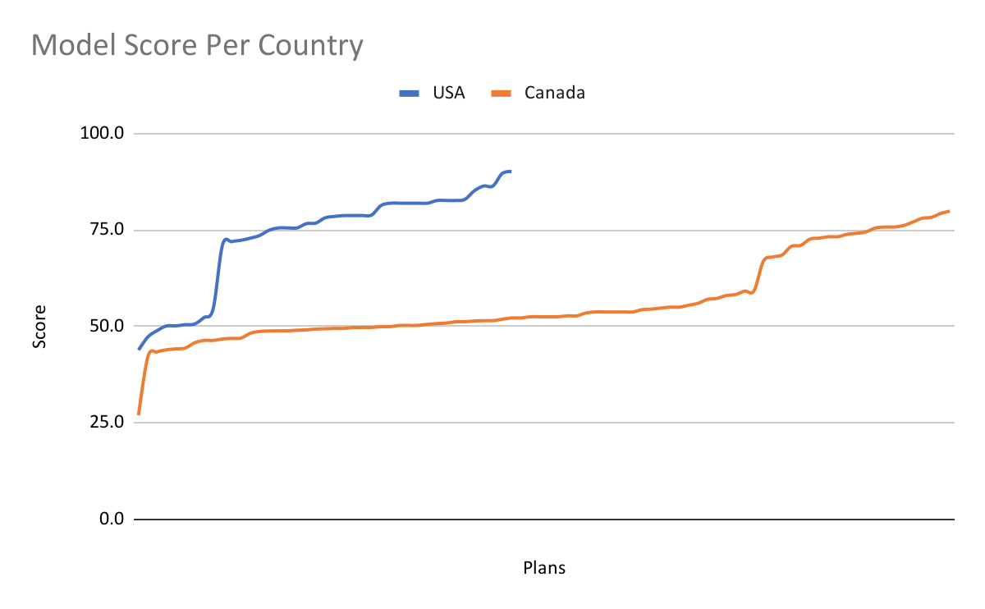
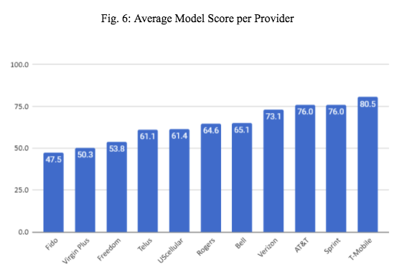
Findings
Notes:
Here we have the findings that we took out from this project. We can see two graphs here that show us the model score per country and per provider.
The model score is calculated by adding all the scores and multiplying them by the importance. Price, local minutes, international minutes, and message kinds are all the factors that go into calculating the model score. Higher factors provide a higher model score. Canadian mobile phone service providers scored 21.9% on average less points than US providers using the scoring model.
From the calculation, it is evident that T-Mobile has the highest model score while Fido scores last i.e. T-Mobile (80.5) and Fido (47.5). Again here, U.S.A cell phone providers have higher model scores than Canadians.

Slide 13
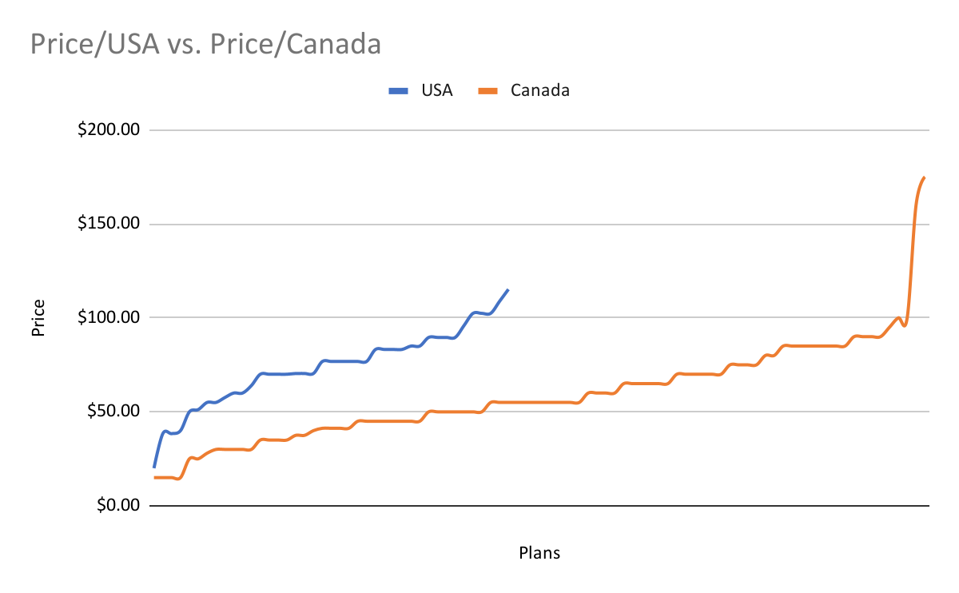
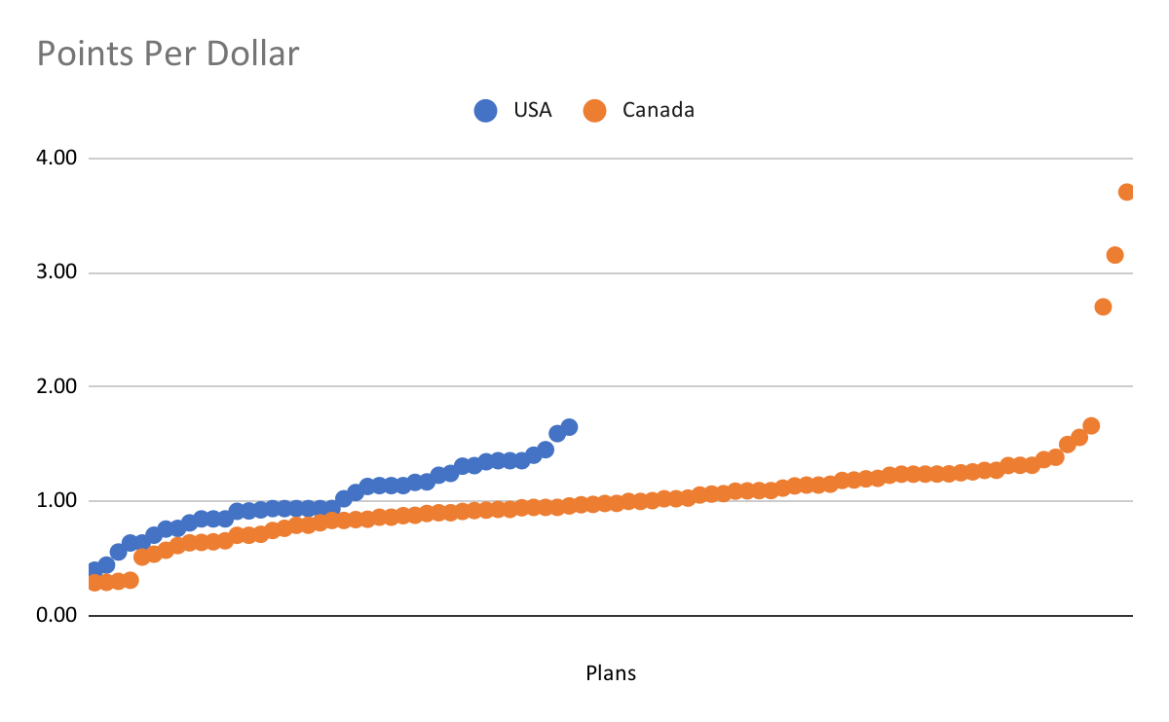
Findings
Notes:
Moving forward we have differences between the cell provider between us and Canada on the basis of price. We can see that the USA is more expensive than Canada. It is significant that even on essential plans like those that just incorporate calls and instant messages, Canadians pay less than Americans. So when data is added in with the general mix, the distinction turns out to be truly evident.
If we move to the next graph we can see that even if the USA pays more it gives more value to its customers, for example if a plan has a higher price it provide more features to its customers like it will give unlimited data, unlimited text and calling and also international services.

Slide 14

Limitations of the Study
Selected Mobile Services or Network Providers
Analysis of data was based on feature selection
Current sentiments through Survey - suggested approach for relevant features
Analysis was based on postpaid plans under Bring your own device scheme
Flanker brands for analysis of Canadian Mobile Service providers
Notes:
Thanks Aman, now on to the details of Limitation of the Study.
The study only consists of the data from selected mobile service providers in Canada and USA. For Canada, the research focuses on Bell, Fido, Freedom, Rogers, Telus, and Virgin Plus. While for the USA, AT&T, Sprint, T-Mobile, US Cellular, and Verizon.
Also, Feature Selection was applied in the data analysis. This means that the importance ranking of the feature selected was based on related literature used as reference for the study.
This will disregard the current market service plan offers that can be gathered through survey and would then give much accurate sentiment of features that matters most.
Then, the data plans selected in the analysis are post-paid plans in a Bring-your-own-device scheme which means the analysis was only made to customers who bring their own device which ignore those who purchase the device with same service plan.
Lastly, it is important to note that there are more Canadian plan providers than US providers because we considered more Canadian flanker brands namely Virgin Plus and Fido.
For the Recommendations, this will be discussed by April.

Slide 15

Recommendations
For BA Managers: Data-driven approach ➔ Better Strategic Decisions
For Telco Companies: Improve plan packages ➔ Improve market share/ gain new revenue stream
For Other Researchers: Know current state ➔ find a purpose for study
Standardize data ➔ easier to process
Use of scope of limitation ➔ more focused study
Notes:
Thank you Fides.
We divided our recommendations to 3 groups that would benefit most from this study.
For BA Managers, we recommend that they adopt a Data-driven approach like what we did here, to make stronger strategic decisions.
For Telco Companies, we recommend that they Improve plan packages. Our research show consumers value data & international call minutes; so telco companies can look into improving on these two key features, and in turn improve their market share or gain new revenue stream.
Lastly, For other researchers: first, we recommend knowing the current state on their topic - so its better to plan and find a purpose for study.
Second, we recommend agreeing on a standard data entry for a cleaner dataset that is easy to process.
And third, we recommend limiting their scope for a more focused study.
Here is Amanpreet again for our conclusion.

Slide 16

Conclusion
Based on data from the telecommunications industries in Canada and the United States, Canadian telecommunications still have a long way to go, with considerable infrastructure to be created in order to provide better services. Furthermore, rather than focusing just on reducing the prices, the government should look for methods to ease the restrictive policies that prohibit new competitors from joining the market.
Notes:
Based on data from the telecommunications industries in Canada and the United States, Canadian telecommunications still have a long way to go, with considerable infrastructure to be created in order to provide better services. Furthermore, rather than focusing just on reducing the prices, the government should look for methods to ease the restrictive policies that prohibit new competitors from joining the market.

Slide 17
THANK YOU!
BAN240 – Business Analytics Capstone Project
Group 4 Members
Mohammed Mukshid Abdul Cader
Lesly Pearl Cortez
Tareq Haboukh
Amanpreet Kaur
April Tolosa
Fides Audrielle Urgel
Professor Stephen Perelgut
Date April 7, 2022
Notes:
YouTube Link: https://www.youtube.com/watch?v=yrUf3lOrEHI

